Slide 1
Reference Books for the slides
1) Introduction to Data Mining
Author: P N Tan, M Steinbach and V Kumar
2) Data Mining: Concepts and Techniques
Author: J Han and M Kamber

Slide 2
Classification
It is the task of assigning objects to one of several predefined categories,
e.g., Detecting spam email messages based upon the message header and content
Input Output
Fig. 1: A schematic illustration of a classification task.
It is the task of learning a target function f that maps each attribute set x to one of the predefined class labels, y.
Classification Model
Attribute set
(x)
Class label
(y)

Slide 3
Types
1. Descriptive modeling
2. Predictive modeling
Descriptive modeling
- A classification model can serve as a tool to distinguish between objects of different classess.
Predictive modeling
A classification model can also be used to predict the class label of unknown records.
Example
- Classify a person as a high, medium or low income group

Slide 4
Table 4.1: Mammal classification
Name | Body temp | Skin cover | Gives birth | Aquatic creature | Aerial creature | Has legs | Hibernates | Class label
Human | Warm-blooded | Hair | Yes | No | No | Yes | No | Mammal
Python | Cold-blooded | Scales | No | No | No | No | Yes | Reptile
Salmon | Cold-blooded | Scales | No | Yes | No | No | No | Fish
… | …. | … | … | … | … | … | … | …

Slide 5
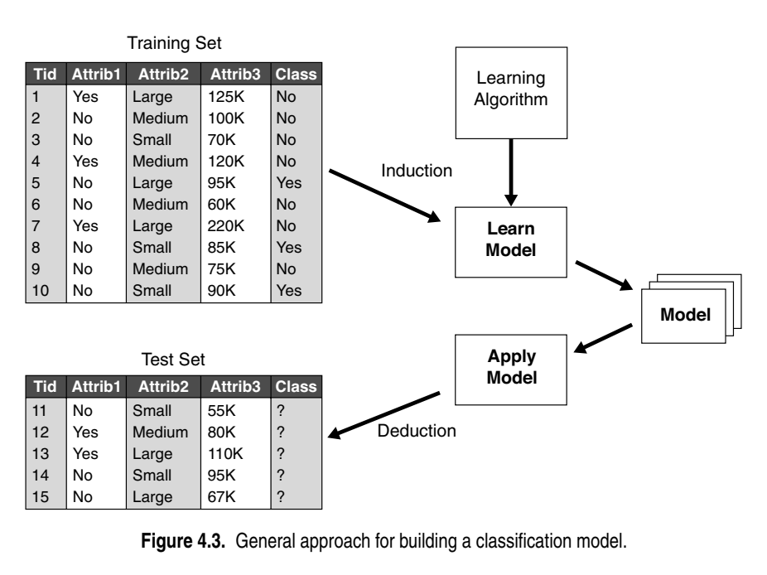
General approach for building a classification model
A classification technique or a classifier is a systematic approach to building classification models from an input dataset .E.g. decision tree classifiers, rule-based classifiers, neural networks etc.
Each technique employs a learning algorithm to identify a model that best fits the relationship between the attribute set and class label of the input data. The model generated by a learning algorithm
should both fit the input data well and correctly predict the class labels of records it has never seen before

Slide 6
A training set is used to train the model. It consists of labeled data where each data instance (row) has a known class.
Attributes (e.g., Attrib1, Attrib2, Attrib3) represent the features or characteristics of the data, while the class is the label
The learning algorithm is the method used to build the classification model. It analyzes the training set, looking for patterns or relationships between the attributes and the class.
Once the model is learned, it is tested using a test set, which consists of new, previously unseen data. The test set is used to evaluate the performance of the model.
The model is evaluated based on how accurately it predicts the class for the test data.

Slide 7
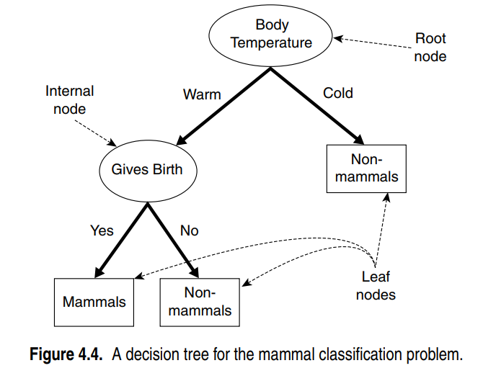
Decision tree Induction
A decision tree is a hierarchical structure consisting of nodes and directed edges.
The tree has 3 types of nodes:
  Root
  Internal nodes
  Leaf or terminal nodes
Each leaf node is assigned a class label. The non-terminal nodes (root, internal nodes) contain attribute test conditions to separate records that have different characteristics
Classifying a test record is easy once a decision tree has been constructed

Slide 8
Starting at the root (based on information gain), we apply the test condition to the record and follow the appropriate branch based on the outcome of the test.
This will result another internal node (based on information gain), for which a new test condition is applied, or to a leaf node.

